Slide 1
Pearson English One

Slide 2
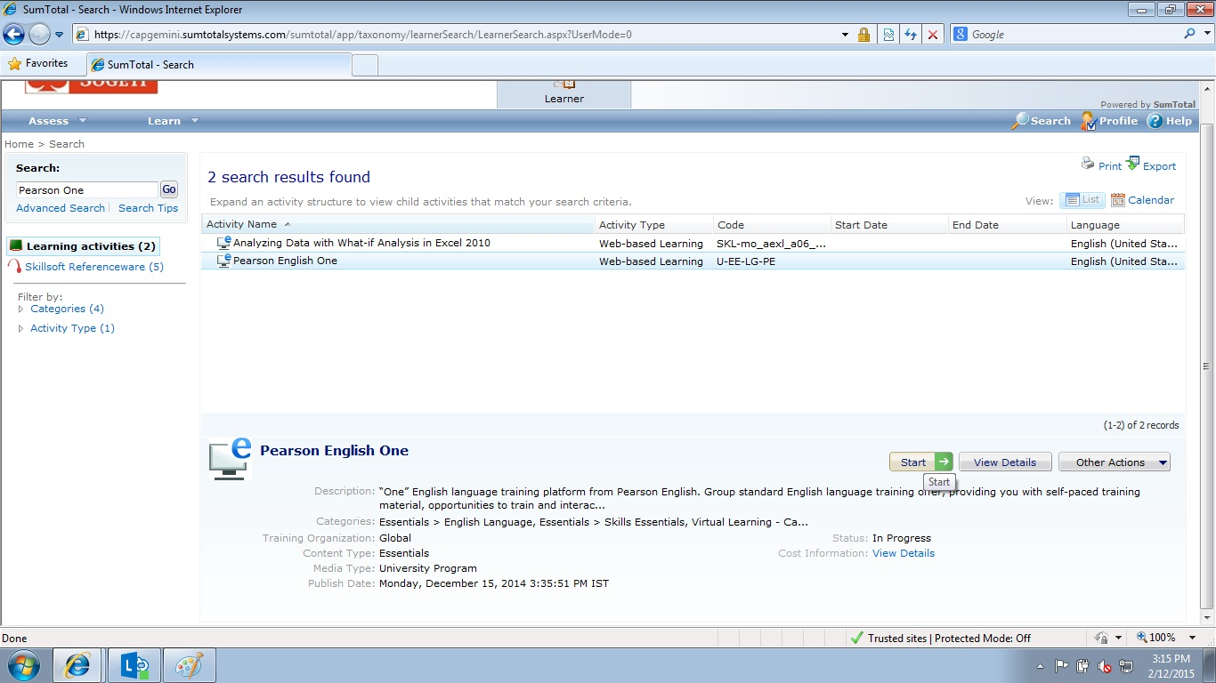
Click on “Start” under Pearson English One( Shown in this slide)

Slide 3
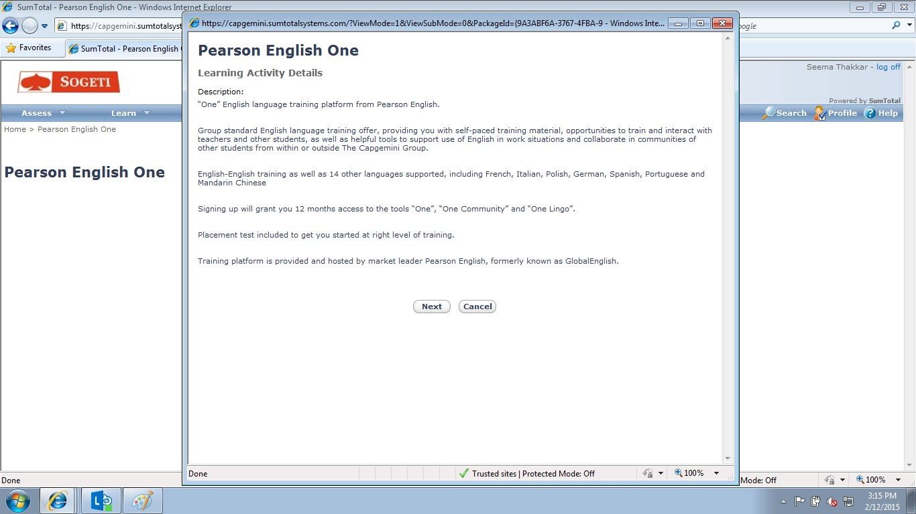
Click on “Next” ( Shown in this slide)

Slide 4
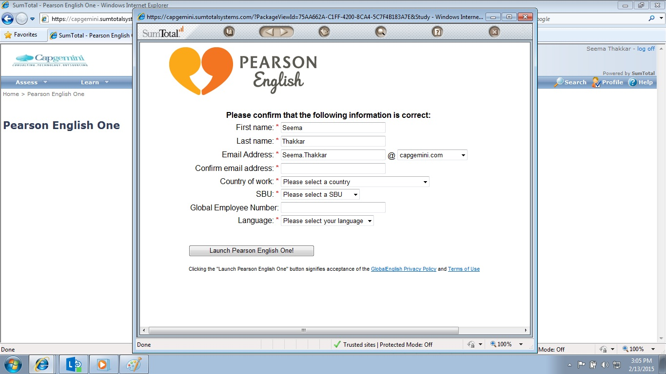
Fill in all your details excluding global employee number

Slide 5
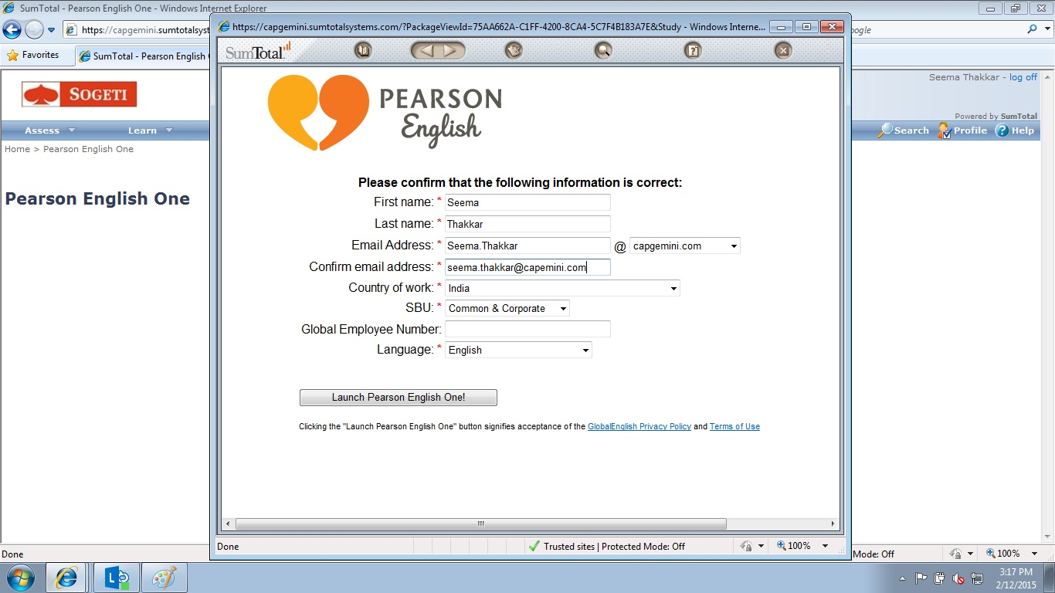
Click on “Launch Pearson English One” ( Shown in this slide)

Slide 6
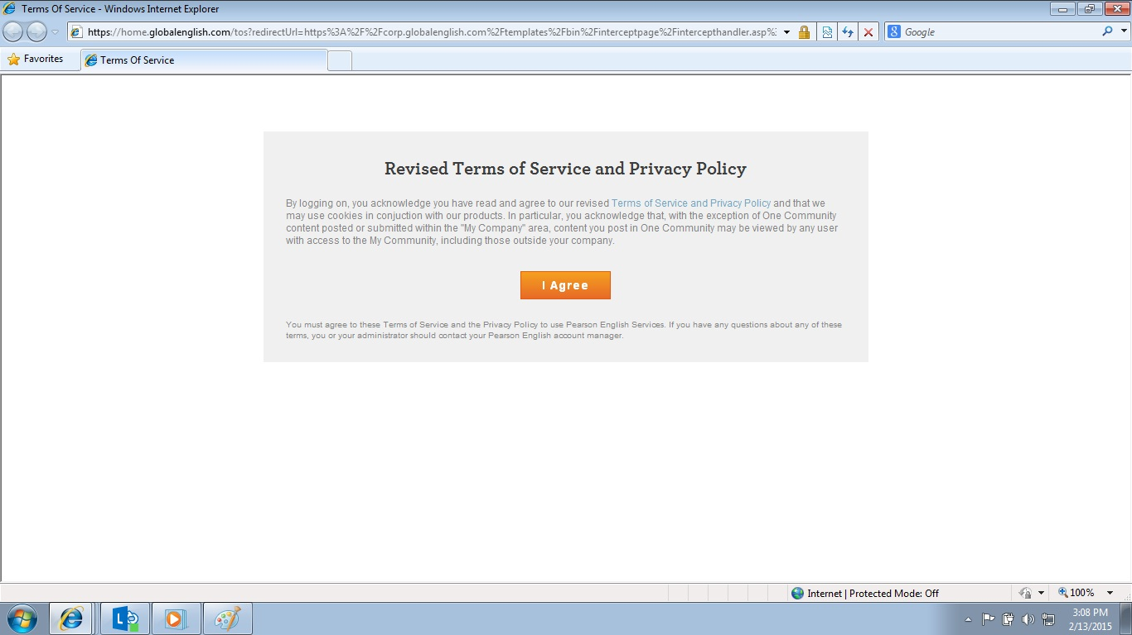
Click on “I Agree” ( Shown in this slide)

Slide 7

Click on “Get Started” ( Shown in this slide)

Slide 8
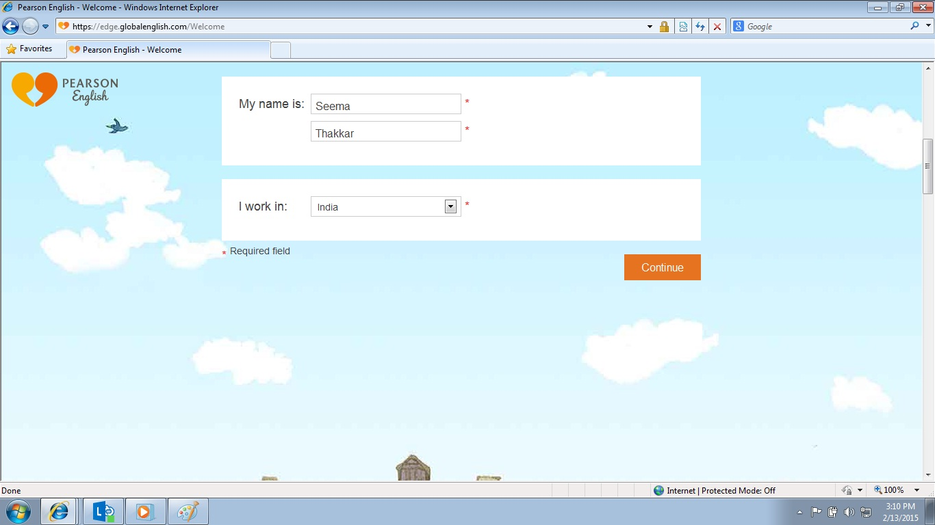
Check your details & Click on “Continue”( Shown in this slide)

Slide 9
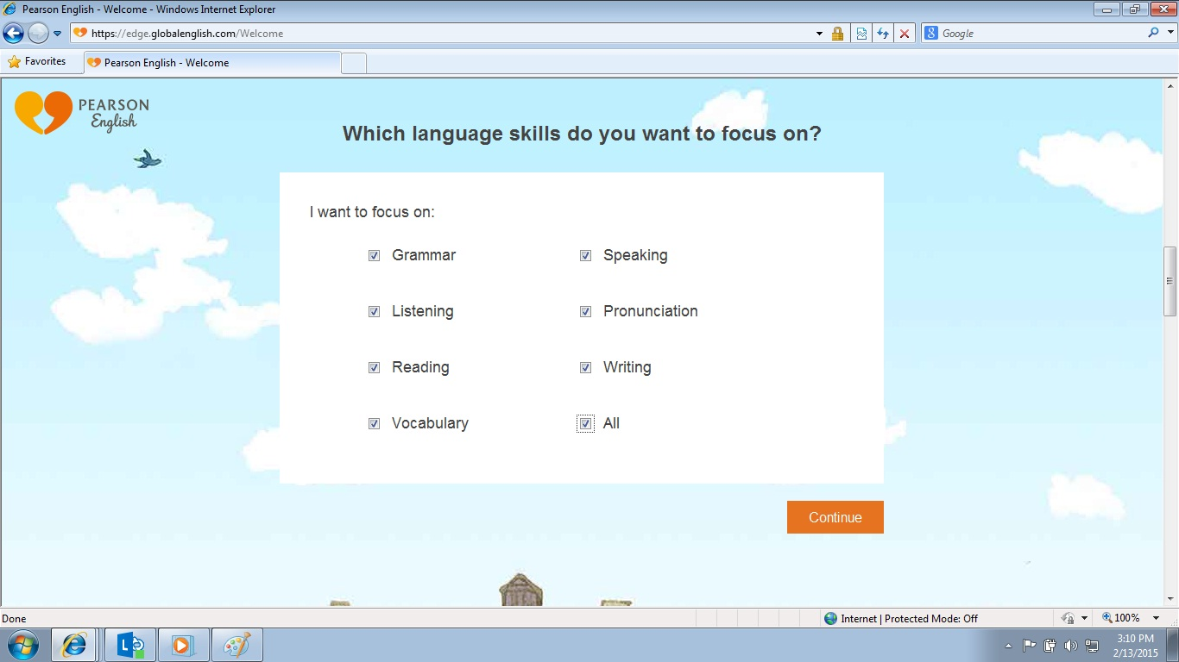
Select “ALL” option and click on “Continue (Shown in this slide)

Slide 10
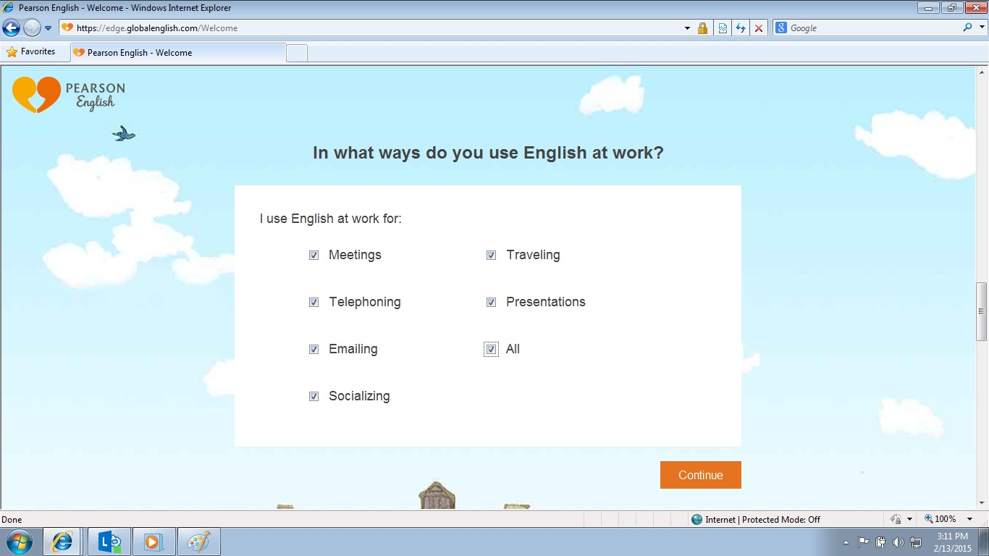
Select “ALL” option and click on “Continue (Shown in this slide)

Slide 11
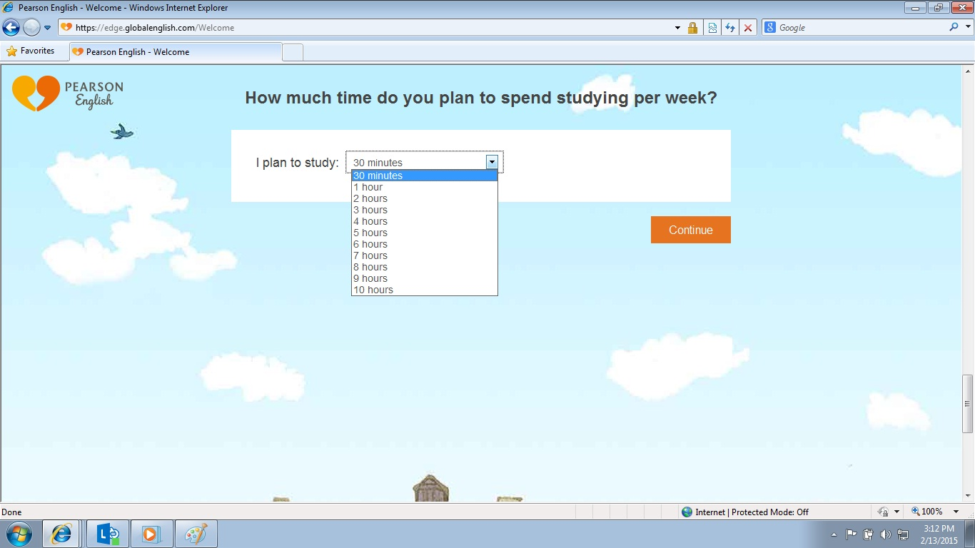
Select your desired study plan & click on “Continue”

Slide 12
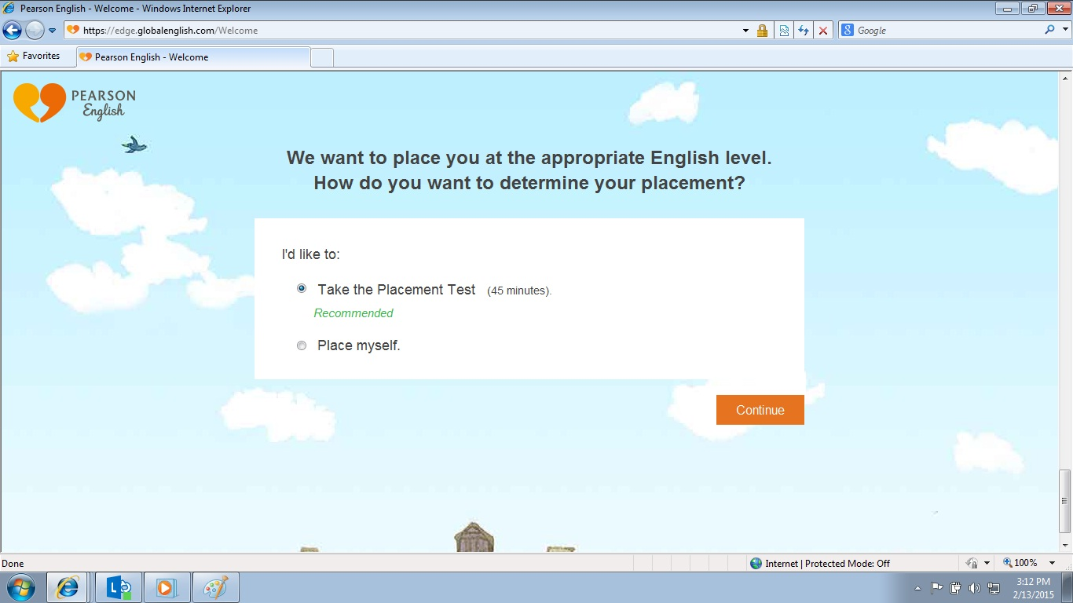
Select “Take the Placement Test ( 45 minutes)” & Click on “Continue”

